Slide 1
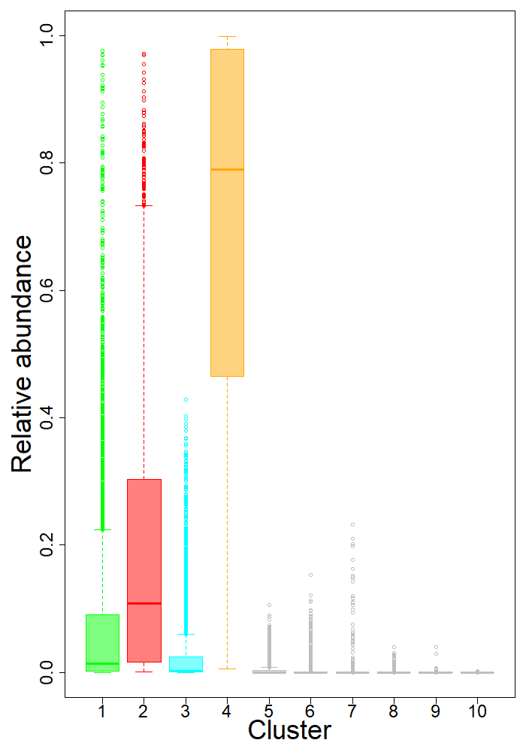
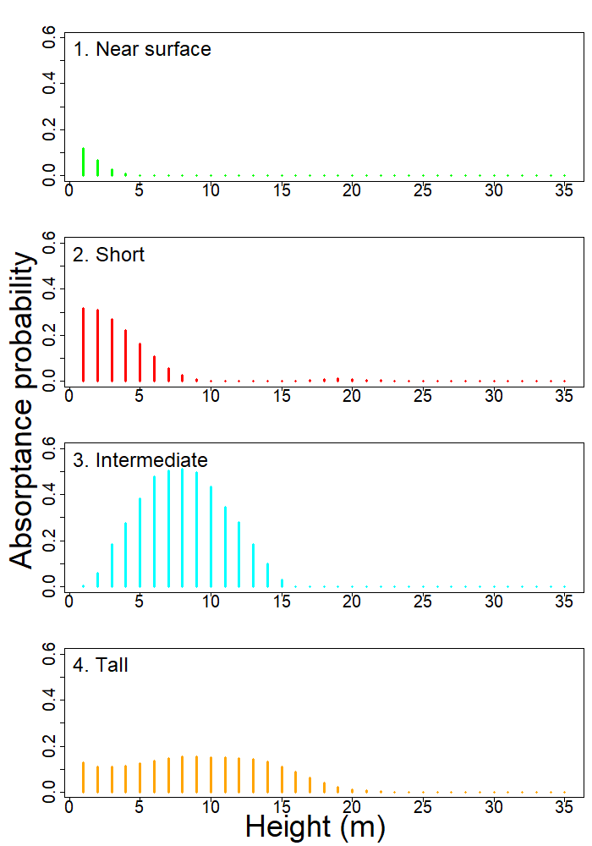
A. Relative abundance
B. Vertical profile
C. Schematic diagram
50 m
50 m
50 m
50 m
50 m
50 m
50 m
50 m

